Slide 1


Slide 2
Model Evaluation

Slide 3
Distance Metrics

Slide 4
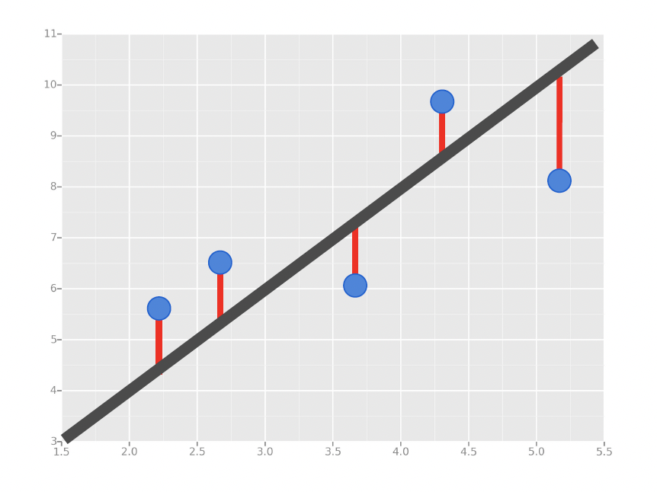
Distance Metrics
In Supervised Learning, we’re concerned with minimizing the distance between our model (e.g. line, curve, etc.) and the gathered data.

Slide 5
Error Metrics
Distance Metrics
In Supervised Learning, we’re concerned with minimizing the distance between our model (e.g. line, curve, etc.) and the gathered data.
For problems with continuous targets (i.e. Regression), there are three common ways we measure distance:
Mean Absolute Error (MAE)
Mean Squared Error (MSE)
Root Mean Squared Error (RMSE)

Slide 6

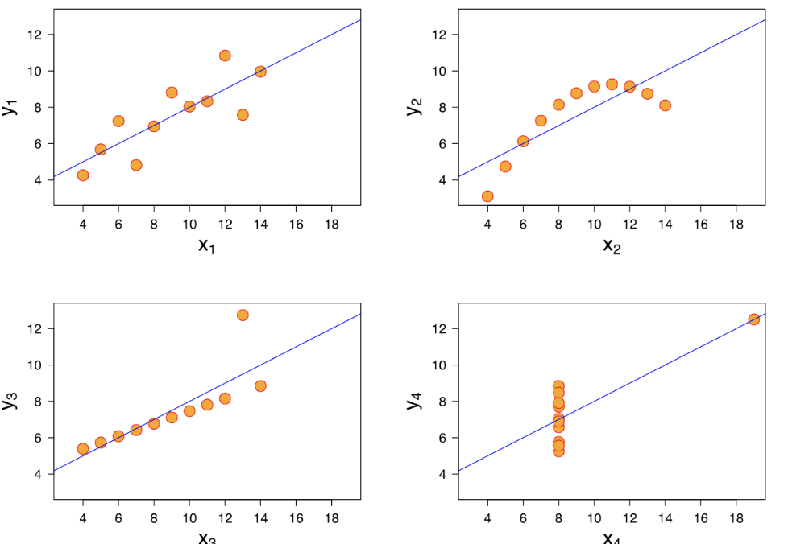
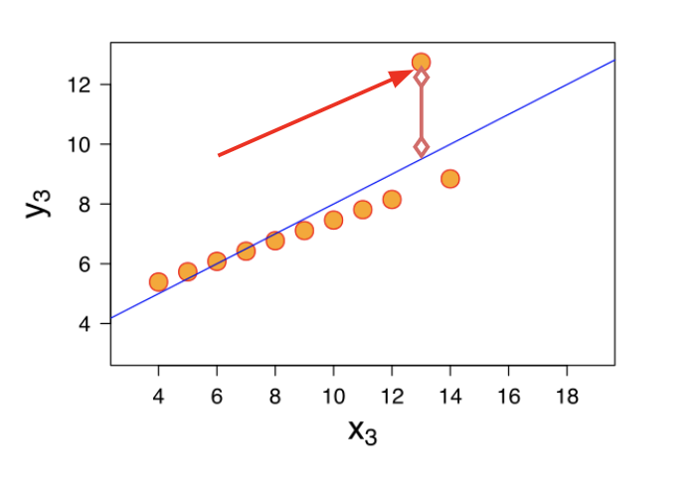
Error Metrics
Distance Metrics
Mean Absolute Error (MAE)
This is the mean of the absolute value of errors.
Easy to understand
MAE won’t punish large errors
We want our error metrics to account for these!
Notes:
Let’s take a moment now to discuss evaluating Regression Models
Regression is a task when a model attempts to predict continuous values (unlike categorical values, which is classification)
You may have heard of some evaluation metrics like accuracy or recall.
These sort of metrics aren’t useful for regression problems, we need metrics designed for continuous values!
Can you give me continuous versus categorical variables?

Slide 7
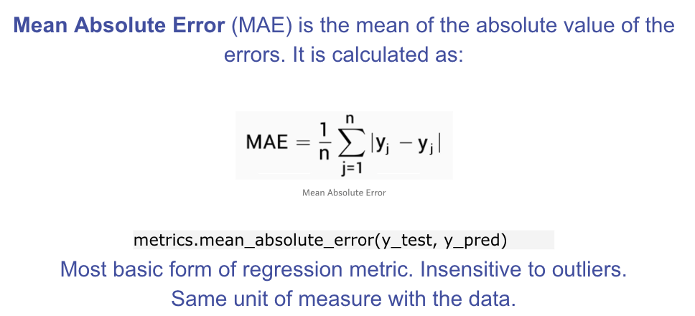
Error Metrics
Distance Metrics

Slide 8
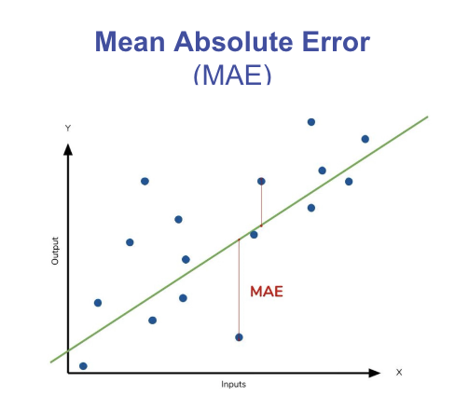
Error Metrics
Distance Metrics

Slide 9
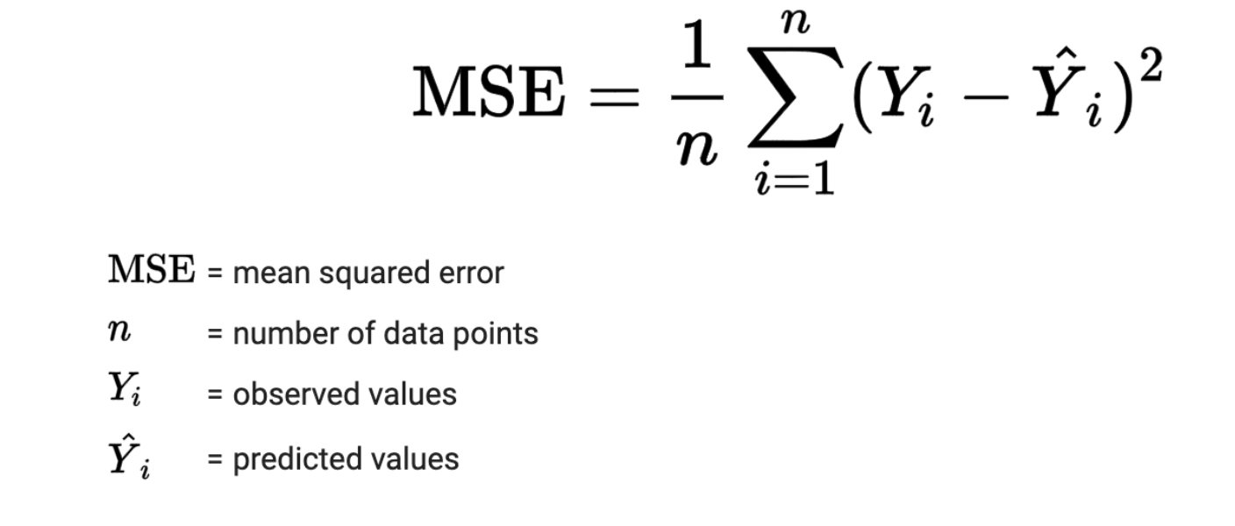
Error Metrics
Distance Metrics
Mean Squared Error (MSE)
This is the mean of the squared errors.
Larger errors are noted more than with MAE, making MSE more popular.
Notes:
Let’s take a moment now to discuss evaluating Regression Models
Regression is a task when a model attempts to predict continuous values (unlike categorical values, which is classification)
You may have heard of some evaluation metrics like accuracy or recall.
These sort of metrics aren’t useful for regression problems, we need metrics designed for continuous values!

Slide 10
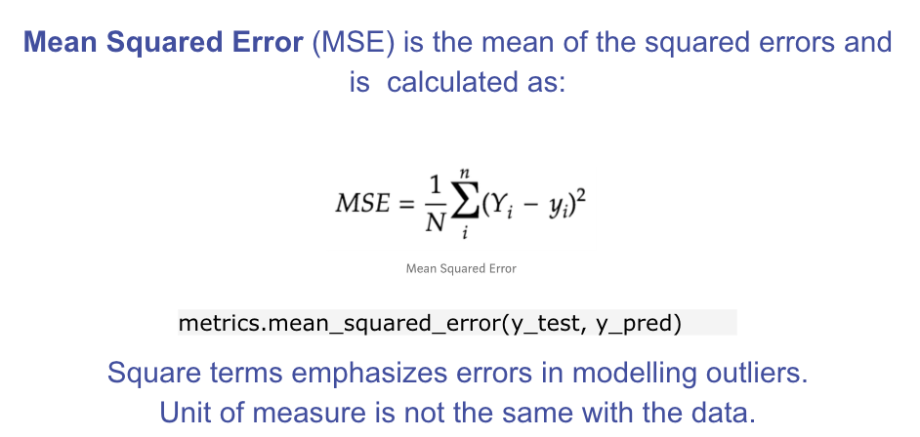
Error Metrics
Distance Metrics
These formulas can be coded up to determine an iterative way to print out the MSE.
Notes:
Let’s analyze what this equation actually means.
In mathematics, the character that looks like weird E is called summation (Greek sigma). It is the sum of a sequence of numbers, from i=1 to n. Let’s imagine this like an array of points, where we go through all the points, from the first (i=1) to the last (i=n).
For each point, we take the y-coordinate of the point, and the y’-coordinate. The y-coordinate is our purple dot. The y’ point sits on the line we created. We subtract the y-coordinate value from the y’-coordinate value, and calculate the square of the result.
The third part is to take the sum of all the (y-y’)² values, and divide it by n, which will give the mean.
Our goal is to minimize this mean, which will provide us with the best line that goes through all the points.

Slide 11
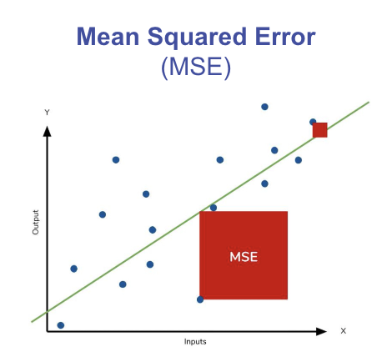
Error Metrics
Distance Metrics

Slide 12

Error Metrics
Distance Metrics
Root Mean Square Error (RMSE)
This is the root of the mean of the squared errors.
Most popular (has same units as y)
Common question: “Is this value of RMSE good?”
Context is everything!
A RMSE of $10 is fantastic for predicting the price of a house, but horrible for predicting the price of a candy bar!
Notes:
Compare your error metric to the average value of the label in your data set to try to get an intuition of its overall performance.
Domain knowledge also plays an important role here!
Context of importance is also necessary to consider.
We may create a model to predict how much medication to give, in which case small fluctuations in RMSE may actually be very significant.
Root Mean Square Error (RMSE) is the standard deviation of the residuals (prediction errors). Residuals are a measure of how far from the regression line data points are; RMSE is a measure of how spread out these residuals are. In other words, it tells you how concentrated the data is around the line of best fit. Root mean square error is commonly used in climatology, forecasting, and regression analysis to verify experimental results.

Slide 13
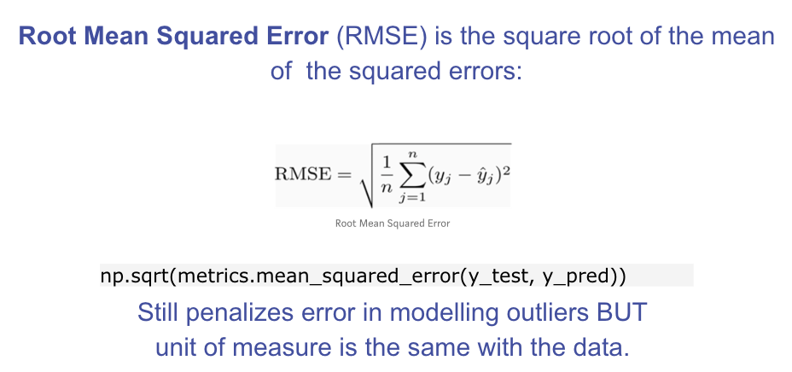
Error Metrics
Distance Metrics

Slide 14
Error Metrics
Distance Metrics
How do we measure “goodness of fit”/”distance” when our outcome is binary (or more broadly, categorical)?

Slide 15
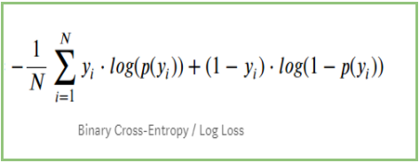
Error Metrics
Distance Metrics
How do we measure “goodness of fit”/”distance” when our outcome is binary (or more broadly, categorical)?
LogLoss (Cross-Entropy):
Used for binary classification problems (0, 1)
Measures the distance between actual values (0, 1) and the probabilities returned by the model (e.g. 0.5, 0.8, 0.9)

Slide 16
Error Metrics
Distance Metrics
LogLoss (Cross-Entropy):
Used for binary classification problems (0, 1)
Measures the distance between actual values (0, 1) and the probabilities returned by the model (e.g. 0.5, 0.8, 0.9)
Baseline Model: Uninformative Model (randomly guessing)

Slide 17
Error Metrics
Distance Metrics
In Supervised Learning, we’re concerned with minimizing the distance between our model (e.g. line, curve, etc.) and the gathered data.

Slide 18
Error Metrics
Distance Metrics
In Supervised Learning, we’re concerned with minimizing the distance between our model (e.g. line, curve, etc.) and the gathered data.
What are some surefire ways in which we can minimize our distance metrics?

Slide 19
Error Metrics
Distance Metrics
In Supervised Learning, we’re concerned with minimizing the distance between our model (e.g. line, curve, etc.) and the gathered data.
What are some surefire ways in which we can minimize our distance metrics?
Better Features
More Features

Slide 20
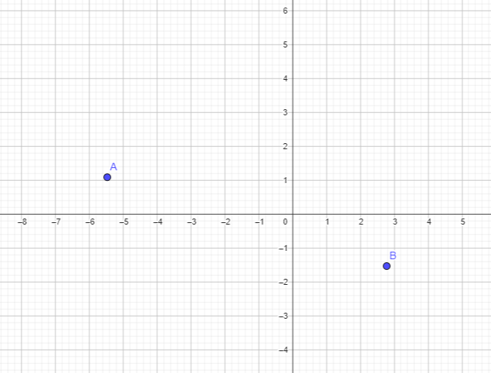
Error Metrics
Distance Metrics
Consider polynomial functions (for easy visualization):
Given 2 data points, what’s the smallest degree polynomial that will perfectly hit both points?

Slide 21
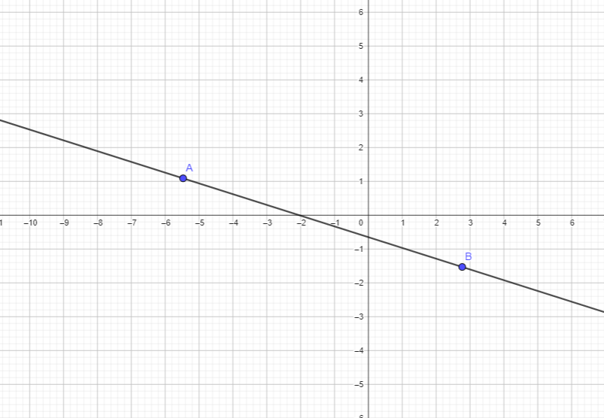
Error Metrics
Distance Metrics
Consider polynomial functions (for easy visualization):
Given 2 data points, what’s the smallest degree polynomial that will perfectly hit both points?
Smallest Degree = 1 (line): mx + b

Slide 22
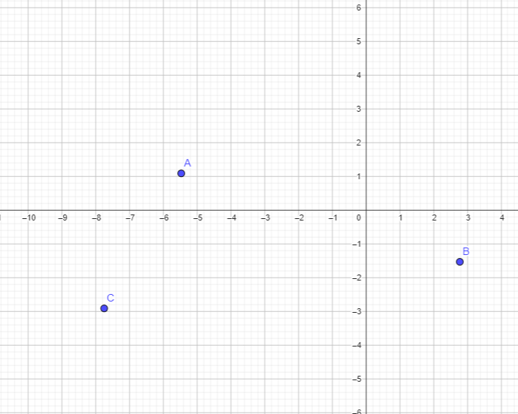
Error Metrics
Distance Metrics
Consider polynomial functions (for easy visualization):
Given 3 data points, what’s the smallest degree polynomial that will perfectly hit both points?

Slide 23
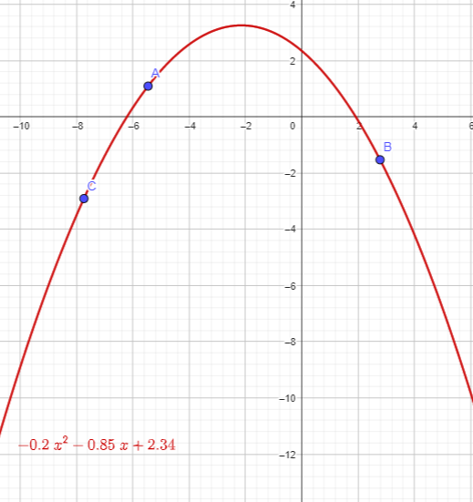

Error Metrics
Distance Metrics
Consider polynomial functions (for easy visualization):
Given 3 data points, what’s the smallest degree polynomial that will perfectly hit both points?
Degree = 2 (Quadratic form):

Slide 24
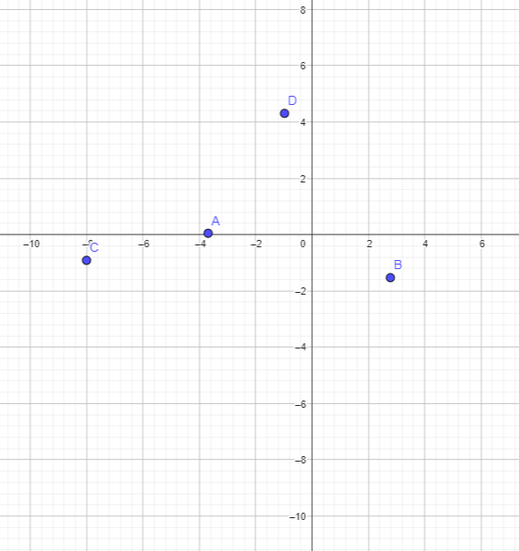
Error Metrics
Distance Metrics
Consider polynomial functions (for easy visualization):
Given 4 data points, what’s the smallest degree polynomial that will perfectly hit both points?

Slide 25
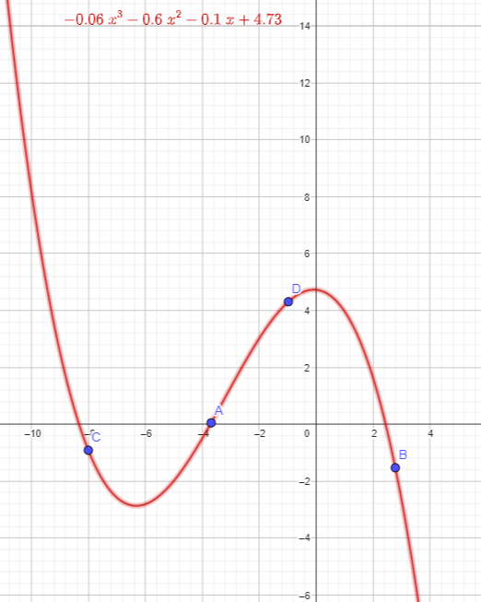
Error Metrics
Distance Metrics
Consider polynomial functions (for easy visualization):
Given 4 data points, what’s the smallest degree polynomial that will perfectly hit both points?
Degree = 3 (cubic form)

Slide 26
Error Metrics
Distance Metrics
In general, if we have n data points, we can find a “line” (or hyperplane) that hits all these points perfectly if we use n-1 variables/dimensions.

Slide 27
Error Metrics
Distance Metrics
In general, if we have n data points, we can find a “line” (or hyperplane) that hits all these points perfectly if we use n-1 variables/dimensions.
Is this something we want?

Slide 28
Error Metrics
Distance Metrics
For continuous cases (regression):
What would be a good baseline model?

Slide 29
Performance Metrics

Slide 30
Performance Metrics
Low enough error metrics, but not too low…
How do we evaluate these?

Slide 31
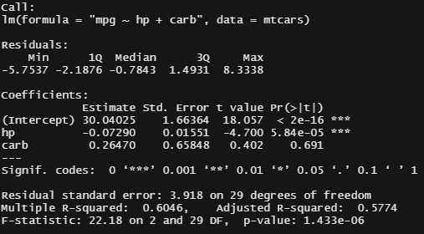
Performance Metrics

Slide 32
Performance Metrics
Residuals: distances between model and data points (y - y_est)
Degrees of freedom (DF): Sample Size - # of Variables (Typically)

Slide 33
Performance Metrics
Residual Standard Error:
Sqrt. of the Sum of Squared Residuals, divided by a denominator based on deg. of freedom s.t. denominator is higher as d.f. increases.

Slide 34
Performance Metrics
R-Squared: % of data’s variability the model is able to account for (~goodness of fit)
Basic/Multiple R-Squared: always approaches 1 as # of variables increases

Slide 35
Performance Metrics
Adjusted R-Square:
Same concept as Multiple R-Squared, but computed such that a penalty is applied for each additional variable included

Slide 36
Testing Metrics

Slide 37
Testing Metrics
Aside from fit metrics that penalize overfitting, we can also make use of methods that split our data into test/train sets (or cross-validations).

Slide 38
Testing Metrics
Aside from fit metrics that penalize overfitting, we can also make use of methods that split our data into test/train sets (or cross-validations).
For Continuous Cases:
We can still make use of RMSE, MAE, MSE to check how well the model is able to generalize.

Slide 39
Testing Metrics
Aside from fit metrics that penalize overfitting, we can also make use of methods that split our data into test/train sets (or cross-validations).
For Continuous Cases:
We can still make use of RMSE, MAE, MSE to check how well the model is able to generalize.
For Classification Cases:
LogLoss is still applicable; however, it’s not as easy to interpret as the distance metrics for continuous case.

Slide 40
Error Metrics
Better Features
In Supervised Learning, we’re concerned with minimizing the distance between our model (e.g. line, curve, etc.) and the gathered data.
What are some surefire ways in which we can minimize our distance metrics?
Better Features
More Features

